Slide 1



Slide 2

agenda
Introduction
Data Overview
ETL Process
Challenges
Data model
Summary
Production Analysis
Sales Analysis
Profit Analysis
Recommendations
Conclusion

Slide 3

ABOUT COMPANY
Adventure Works Cycles is a large, multinational manufacturing company that produces and distributes metal and composite bicycles to commercial markets.
The headquarters for Adventure Works Cycles is Bothell, Washington.
In 2000s, Adventure Works Cycles bought a small manufacturing plant in Mexico. Which manufactures several critical subcomponents for the Adventure Works Cycles product line. These subcomponents are shipped to the Bothell location for final product assembly.
In 2001, this manufacturing plant became the sole manufacturer and distributor of the touring bicycle product group.
Coming off a successful fiscal year, Adventure Works Cycles is looking to broaden its market share by targeting their sales to their best customers, extending their product availability through an external Web site, and reducing their cost of sales through lower production costs.

Slide 4
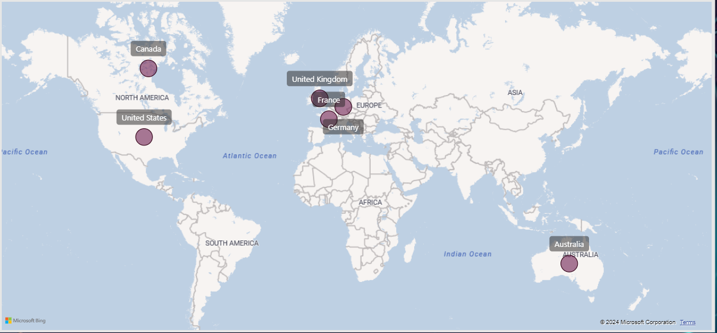
DATA OVERVIEW
Overview
Established Countries
Sales Data is from 10 regions covering 6 Countries.
Data Contains information between 2010 to 2014.

Slide 5

ETL Process
ETL (Extract-Transform-Load) process involves
Extracting data from diverse sources
Accessing the data sources
Establishing connections
Retrieving the necessary data
After establishing the connection, the Power Query Editor provides a range of capabilities for refining, cleaning and transforming the imported data
Flexibility to perform the data cleaning tasks
Set up the relationships between the tables
Load, includes sending the transformed data into the data model.

Slide 6

Challenges
Adapting the transformations between Excel, Tableau, Power bi, SQL and Power Query necessitated a deep understanding of the nuances of each tool's syntax and capabilities.
Each tool presented its own strengths and limitations for data transformation, demanding adaptability in our approach.
Selecting the right visuals in Power BI, Tableau to clearly and effectively represent the insights was a crucial challenge.

Slide 7
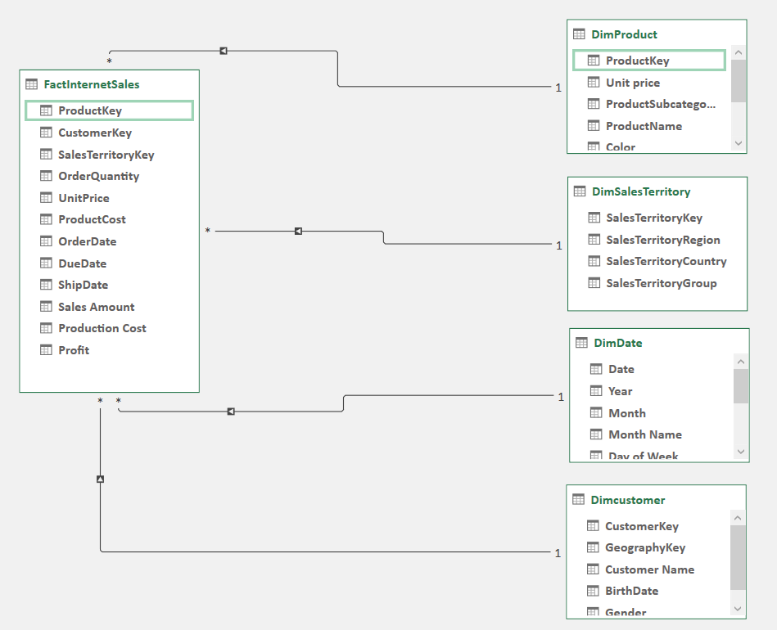
Data model
A picture of the completed model is provided for greater understanding.

Slide 8







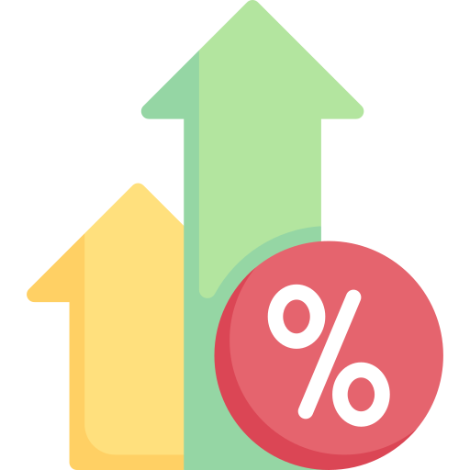
SUMMARY (KPIS)
Total Products
606
Sold Products
158
Total Orders
60,398
Total Customers
18,484
Production Cost
17.28 M
Total Revenue
29.36 M
Total Profit
12.08 M
Profit Margin
41.15%

Slide 9
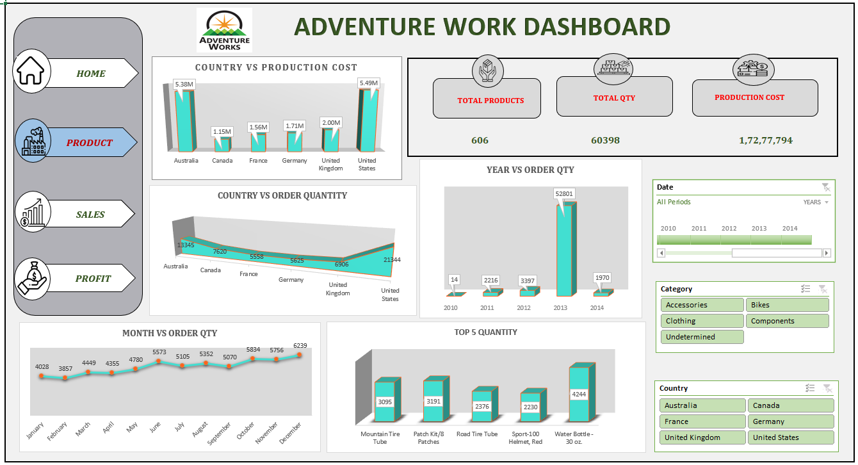
Production Analysis

Slide 10

Production details
There are 4 types of Category
Bikes
Accessories
Clothing
Components
Bike Category generates more revenue and profit.
Total Bikes sold was 15,205 out of this United States has highest Sales qty of 4,907
In Bikes Subcategory, highest sold bikes subcategory was Road bikes – 8,068
The Mountain-200 Black, 46 was the top selling product.
The profit share of the Top 5 products is 24.8% while other products had 75.2%.

Slide 11
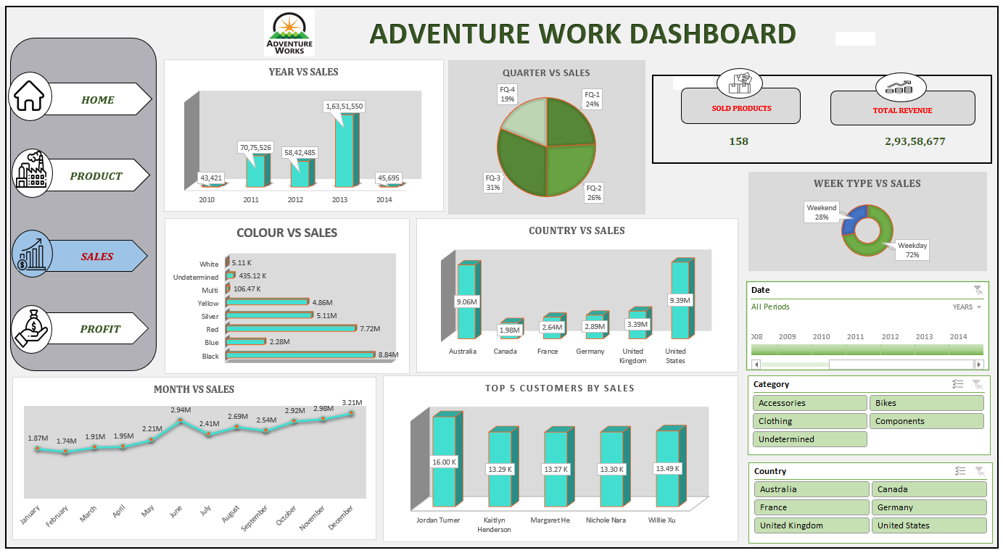
Sales Analysis

Slide 12


Sales details
It serves as the hub for company-wide KPIs, encompassing Revenue, Total sold products along with detailed lists highlighting the top-selling color wise sales and the top 5 customers contributing the most to sales.
The Bikes category generated the highest Revenue of 28.3 M.
56% of total Revenue was generated in the year of 2013.
Out of 6 countries, 63% of revenue was generated from United States & Australia.
Most people prefer to purchase black bikes next to black , red color is most sold bikes.
Jordan Tuner was highest purchased customer, total purchase amount 16 K. He purchased from France and United States.
The top 5 customers shows the purchase worth of 69.35K.

Slide 13
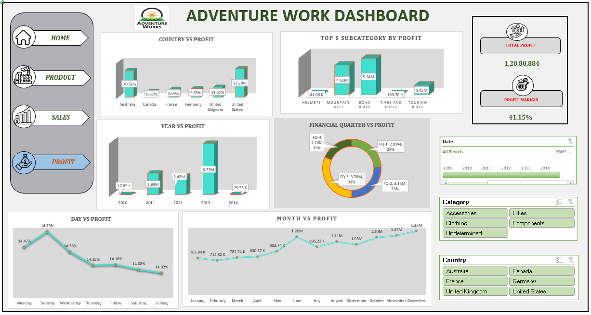
Profit Analysis

Slide 14

Profit details
The nation United States, United Kingdom, Germany, France, Australia, and Canada share 31.29%, 30.51%, 11.51%, 9.83%, 8.99%, and 6.87% of the profit.
Road Bikes Category generate highest Profit of 5.54 M, next to that Mountain Bikes category has Profit of 4.51 M.
The highest profit of amount 6.76 M was recorded in the year of 2013.
In day wise profit, Tuesday has highest profit of 14.73 M.
Highest Profit was recorded in Australia, United States having the total Profit of 7.58 M.
Above 50% Profit was in the year 2013.
Weekend records 39% of total profit.

Slide 15

Recommendation
Based on our comprehensive analysis and insights, here are the future recommendation aimed at enhancing the success of Adventure Work Store:
To increase their market share in every nation, they can sell accessories and clothing on an E-commerce website, making their products always available to consumers.
Finding suppliers who offer the best quality of materials at the lowest wholesale price, a long-term contract with them can help to reduce production costs.
With 448 out of 606 products unsold, there is a significant portion of inventory that is not moving. It may be beneficial to analyze which products are not selling and consider discontinuing them, reducing prices, or implementing marketing strategies to boost sales.
The profit margin of 41.1% is relatively high, indicating good profitability. However, strategies could be implemented to further optimize costs or increase sales, thus boosting overall profits.
With strong performance in Australia and the U.S., focusing on Europe, Africa and Asia will help the company explore new opportunities.

Slide 16

Conclusion
Adventure Works Cycles has a strong foothold in the market, with notable success in the United States and Australia. By expanding its product offerings and leveraging e-commerce, the company has opportunities for growth in both new and existing markets.
Product Performance: The Bikes category is the top performer, generating the highest revenue and profit margins for Adventure Works Cycles.
Geographic Insights: The United States and Australia are the most profitable markets, with these regions contributing significantly to both sales and profit.
Profitability: The company maintains a strong 41.1% profit margin, though further cost optimization and sales growth strategies could enhance profitability.
Yearly Highlights: 2013 was an exceptional year for revenue and profit, suggesting that the market conditions or sales strategies during this period were highly effective. In 2014 there was a dip in revenue.
Growth Opportunities: Expand into European, African, and Asian markets to diversify revenue streams. Increase availability of accessories and clothing through online sales channels to capture additional market segments.
Operational Efficiency: Addressing underperforming products through improved inventory management can help reduce excess stock and boost overall profitability.
These strategies leverage Adventure Works Cycles’ current strengths while opening avenues for expanded market reach and profitability.

Slide 17

Thank You

